Slide 1
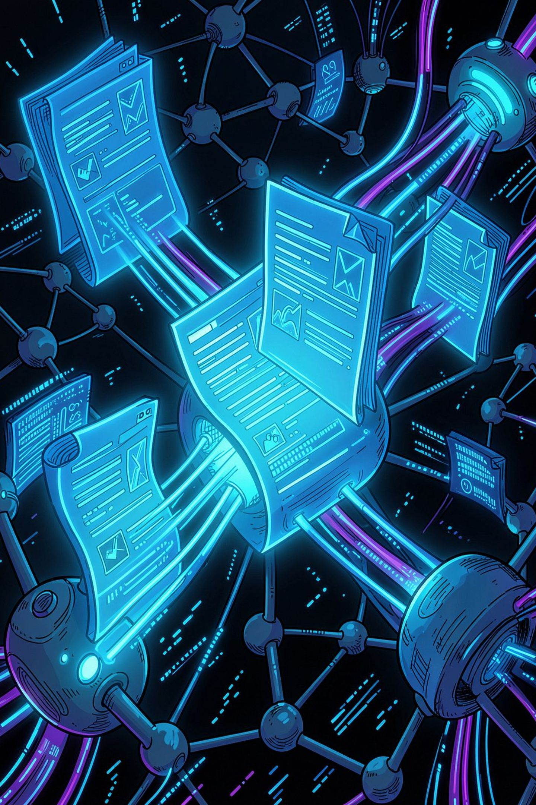
TextHack
High-Performance Duplicate Document Detection & Text Analytics Framework
Pavan | B.Tech Computer Science (AI & DS) | KL University, Hyderabad
Guide: Faculty, Department of CSE (AI & DS) | Academic Year 2024–25

Slide 2
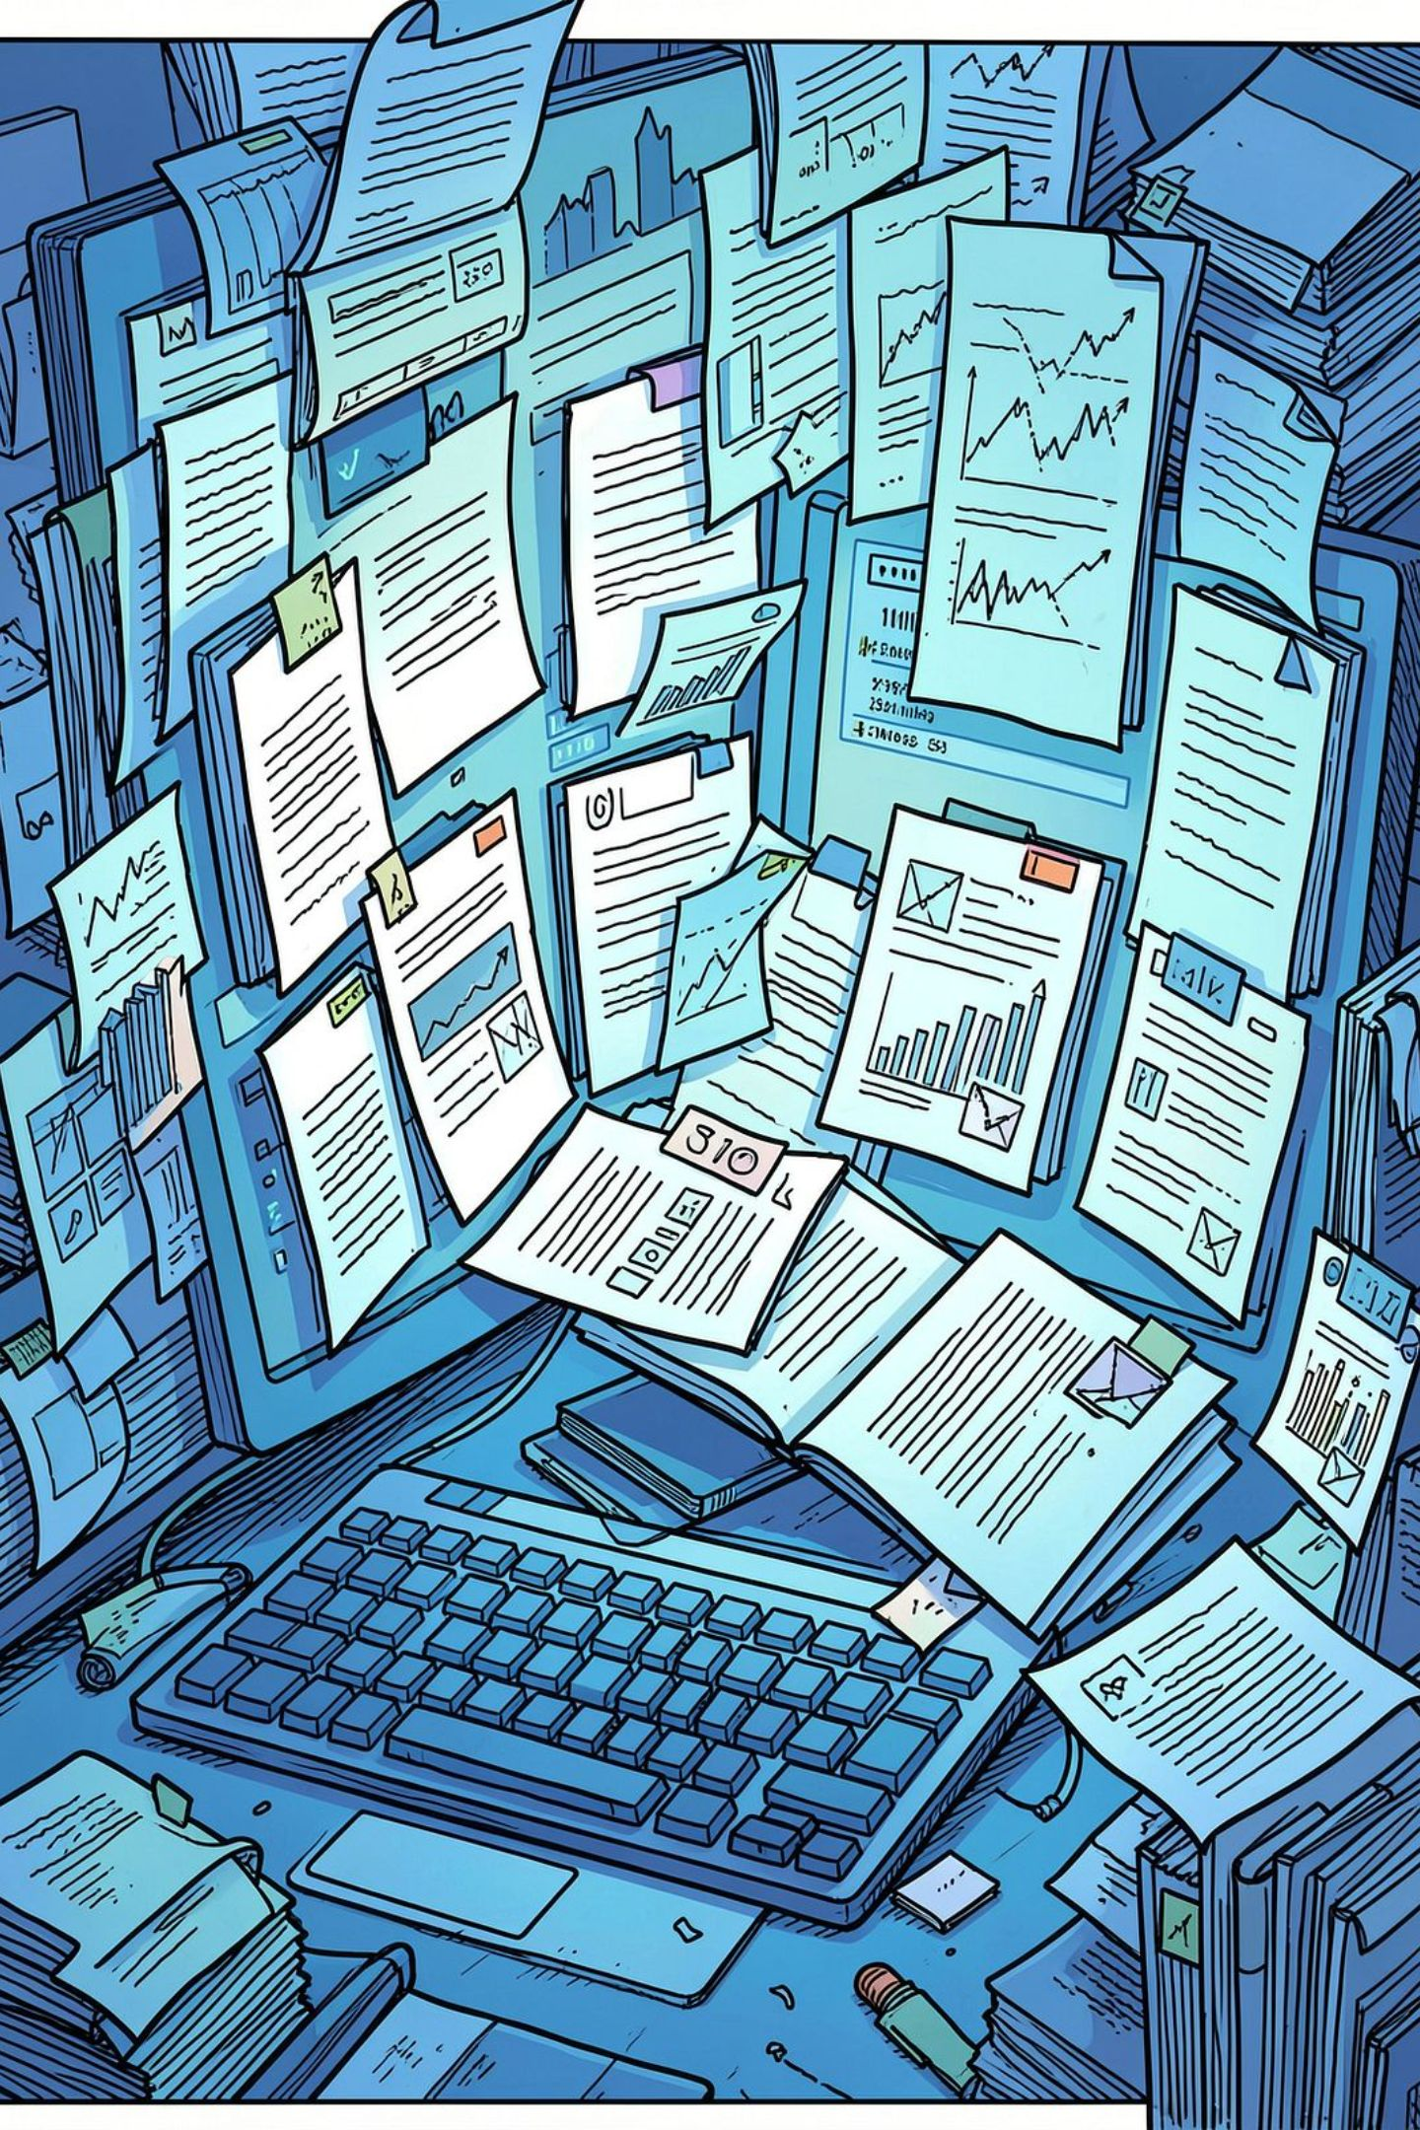
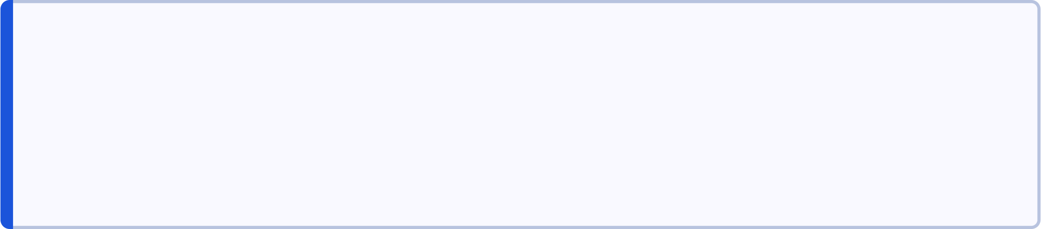
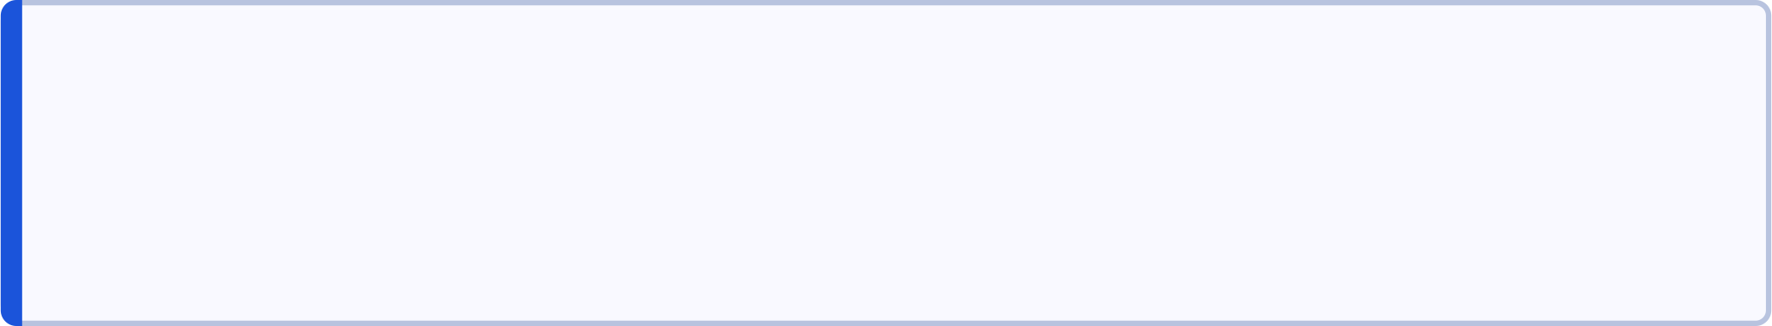
PROBLEM CONTEXT
The Document Explosion Problem
Background
Digital content creation has exploded — academic repositories, legal filings, and codebases now contain billions of documents, making manual redundancy detection infeasible.
The Need
Plagiarism, duplicate submissions, and content redundancy demand automated, scalable detection — yet most tools rely on slow external databases.
Problem Statement
Existing systems suffer O(n²) brute-force latency and external DB lookup bottlenecks, making real-time duplicate detection impractical at scale.

Slide 3
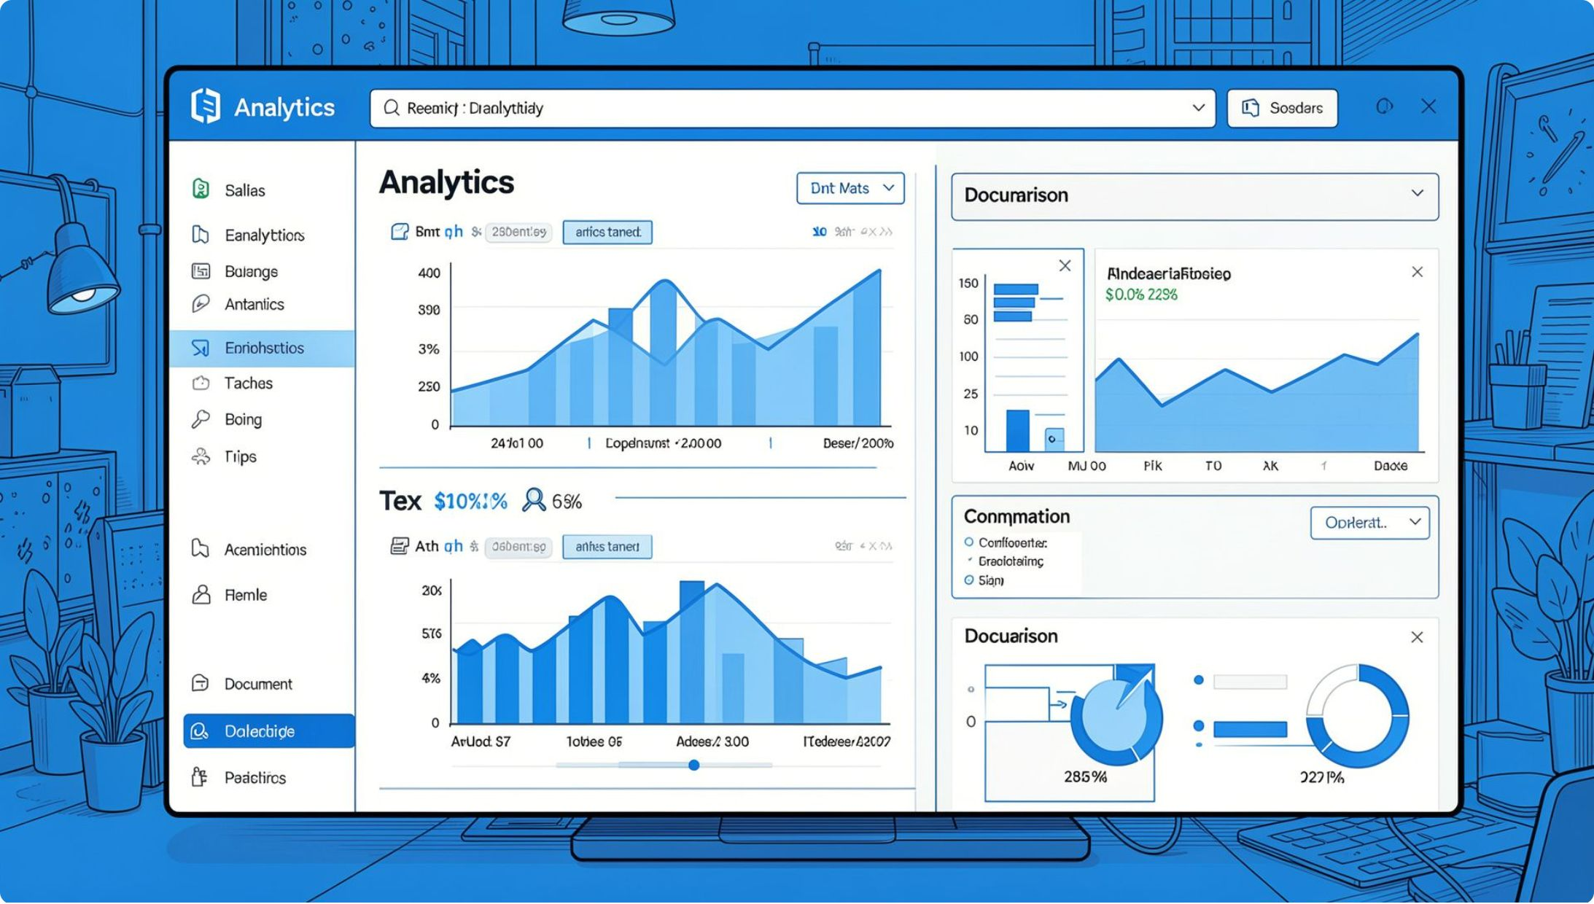
OBJECTIVES & SYSTEM OVERVIEW
What TextHack Sets Out to Achieve
Zero External Dependencies
100% Native Java — no external databases, APIs, or third-party libraries.
Pattern Searching
KMP, Rabin-Karp, and Suffix Array indexing for exact match detection.
Fuzzy Matching
Wagner-Fischer edit distance and sequence alignment for near-duplicate detection.
Similarity & Citation Analysis
Scoring engine with citation graph parsing for academic integrity checks.

Slide 4
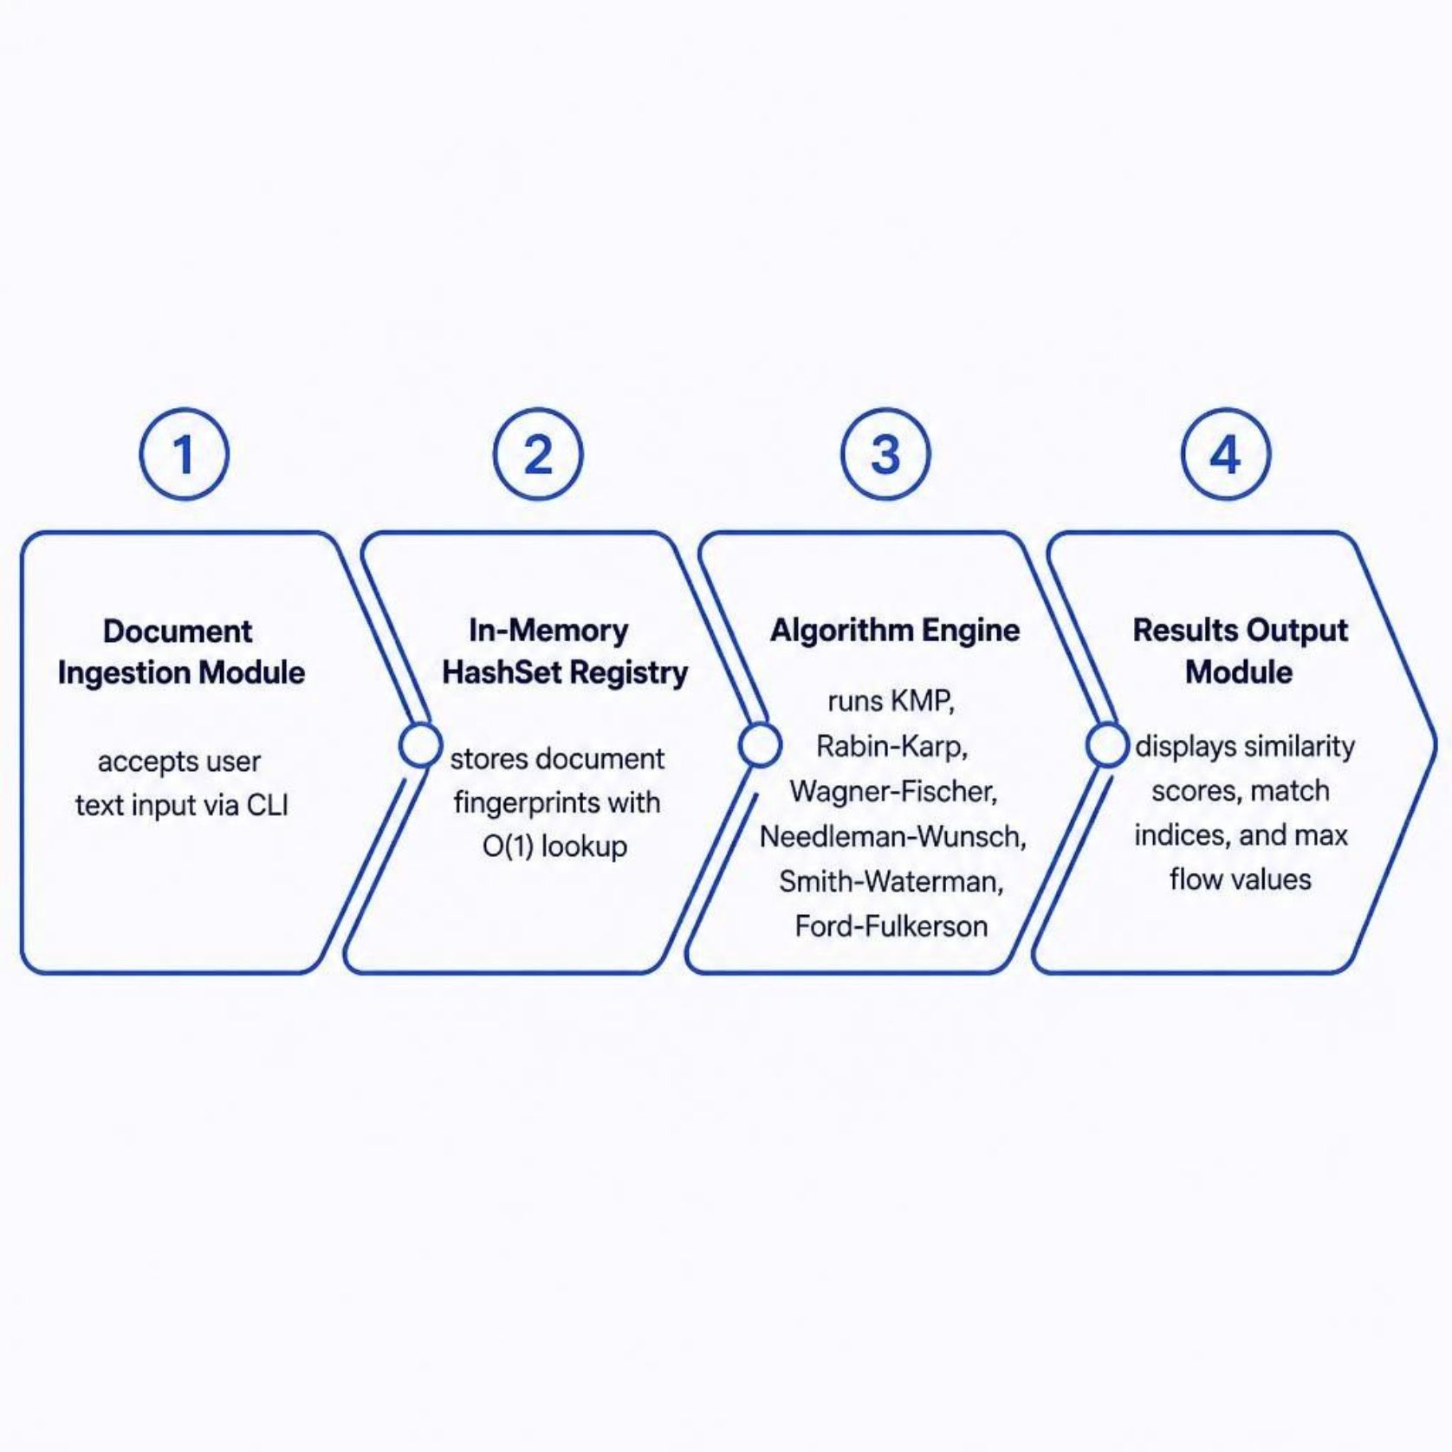
LITERATURE REVIEW & ARCHITECTURE
System Architecture & Prior Work
Limitations of Existing Systems
Turnitin / Plagscan: Cloud-dependent, high latency, subscription-based
Brute-force comparators: O(n²) complexity, no indexing
DB-backed tools: I/O bottlenecks, network overhead
TextHack addresses these gaps with a fully in-memory, modular Java architecture.

Slide 5
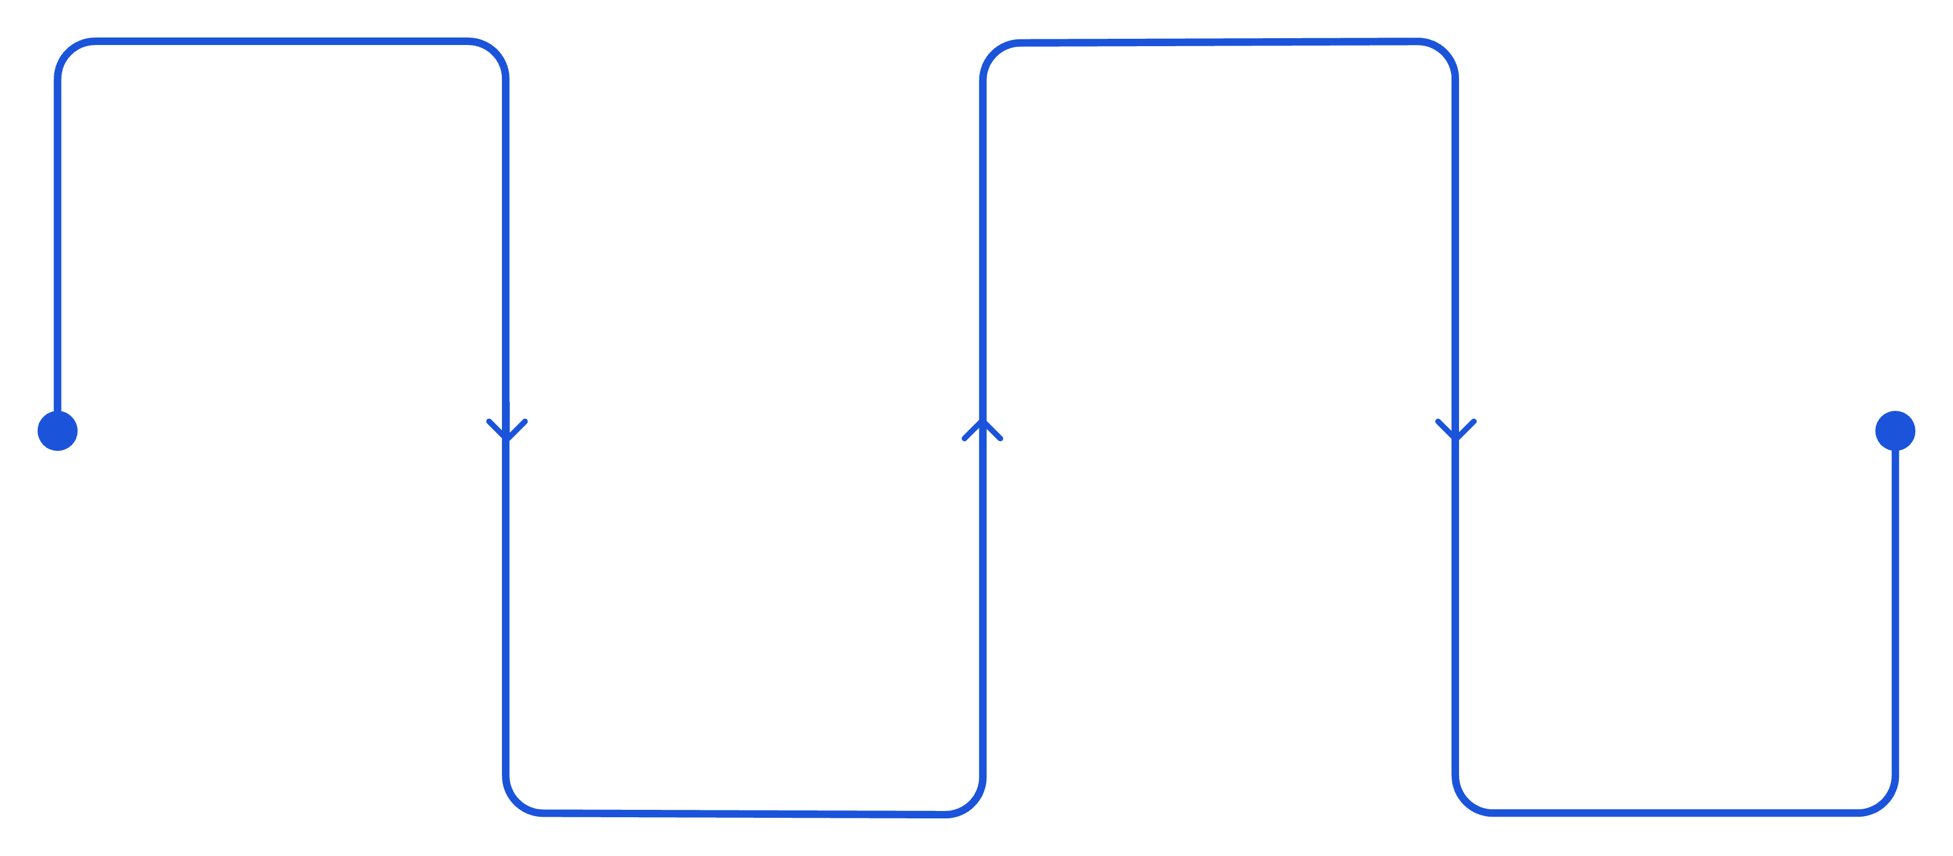
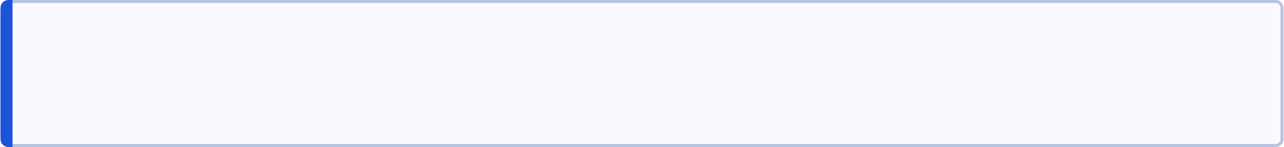
METHODOLOGY — PART 1
Algorithmic Paradigms & Exact String Matching
Naïve Match
Rabin-Karp
O(NM) baseline comparison
Rolling hash for multi-patterns
Suffix Array
KMP
Lexicographic index with Kasai LCP
Linear O(N+M) with LPS table
The pipeline progresses from baseline naïve matching through increasingly optimized algorithms, culminating in suffix-based indexing for large-scale document corpora.
Asymptotic Analysis
Advanced Indexing
Big-O, Ω, Θ bounds formally verified for each algorithm. KMP achieves Θ(N+M) worst-case via Longest Prefix Suffix (LPS) preprocessing.
Rabin-Karp uses rolling hashes for O(N+M) multi-pattern search. Suffix Arrays + Kasai's LCP enable O(N log N) construction with O(M log N) queries.

Slide 6
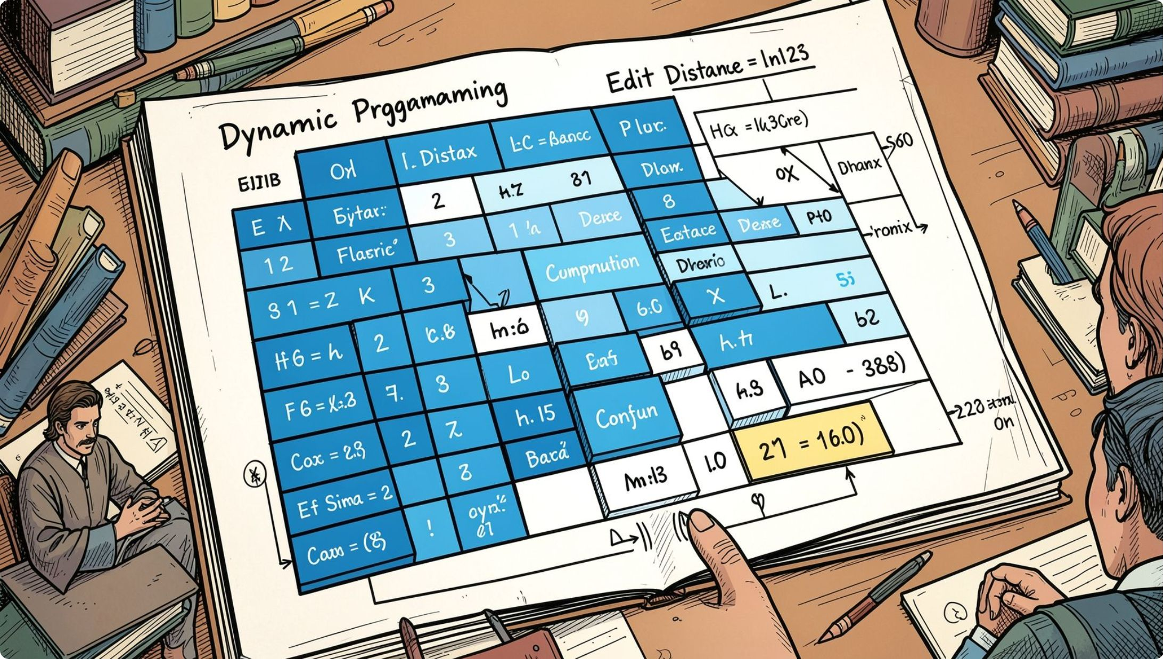
METHODOLOGY — PART 2
Dynamic Programming & Network Flow
1
Wagner-Fischer Edit Distance
DP matrix computes minimum insertions, deletions, and substitutions — O(N·M) time and space for document similarity scoring.
2
Sequence Alignment Models
Needleman-Wunsch (global) and Smith-Waterman (local) detect partial plagiarism and copied subsections with affine gap penalties.
3
Advanced DP Optimizations
Matrix Chain Multiplication and Optimal BST (OBST) demonstrate optimal substructure; Ford-Fulkerson & Edmonds-Karp solve max-flow citation networks.

Slide 7




IMPLEMENTATION
Tools, Technologies & Development Stack
100% Native Java
IntelliJ IDEA
OpenJDK 17+. Zero external libraries — pure algorithmic implementation using Java Collections Framework.
Primary IDE with integrated debugging, JUnit testing, and version control via Git.
Interactive CLI (Main.java)
In-Memory HashSet Registry
Menu-driven interface accepts custom user input, runs duplicate checks, and displays algorithm outputs in real time.
Modular package design with O(1) document fingerprint lookups — no file I/O or database calls during matching.

Slide 8
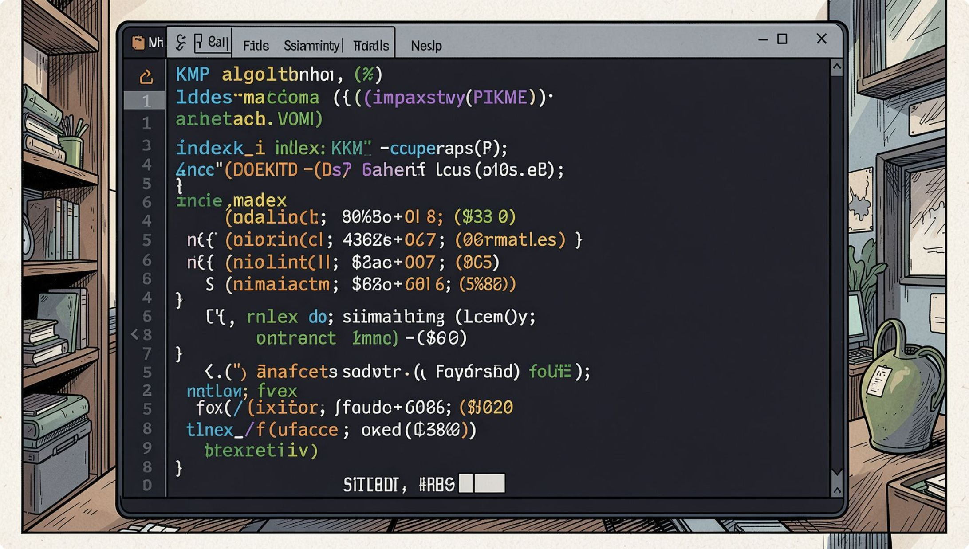

RESULTS & VALIDATION
Test Results & Performance Observations
Key Output Observations
KMP Index Matches: Correct pattern positions returned for all test strings
Max Flow = 12: Ford-Fulkerson validated on sample adjacency matrices
Edit Distance: Wagner-Fischer produced accurate Levenshtein scores
Local Alignment: Smith-Waterman detected partial substring plagiarism
Validation Approach
Test cases covered edge conditions: empty strings, single characters, full duplicates, and near-duplicates with typographical variations.
All algorithms passed functional and boundary test cases with expected asymptotic performance.

Slide 9
IMPACT & CHALLENGES
Advantages, Applications & Lessons Learned
Challenges & Solutions
⚡ Lightning-Fast
🔒 Zero Configuration
Memory overhead for large suffix arrays → mitigated via lazy construction
Hash collisions in Rabin-Karp → resolved with double hashing verification
DP space complexity → optimized using rolling row compression
CLI UX design → iterative refinement based on peer feedback
In-memory operations eliminate I/O latency; KMP and HashSet deliver near-instant lookups.
No database setup, no API keys — plug-and-run on any JVM-enabled machine.
📚 Real-World Use Cases
Plagiarism detection, document clustering, search indexing, and citation network analysis.

Slide 10

CONCLUSION & FUTURE SCOPE
Looking Ahead — Future Enhancements & Summary
Future Roadmap
Conclusion
JavaFX GUI — Replace CLI with an interactive graphical interface for broader usability
TextHack demonstrates that a 100% native Java framework can deliver production-grade duplicate detection — combining KMP, Rabin-Karp, Wagner-Fischer, and Ford-Fulkerson without external dependencies.
Cloud Deployment — Containerize with Docker and deploy on AWS/GCP for scalable access
References
NLP Extensions — Integrate TF-IDF and cosine similarity for semantic duplicate detection
Cormen et al., Introduction to Algorithms (CLRS), 3rd Ed.
Sedgewick & Wayne, Algorithms, 4th Ed.
Oracle OpenJDK Documentation, Java 17
Wagner & Fischer (1974), String-to-String Correction

